Slide 1

Engineering shop lab Fridge door alarm on PCB
Presented by –
Group-05
Section- e
American International University Bangladesh

Slide 2
Group members:
Student’s Serial no | Student’s Name | ID | Dept.
10 | RAHMAN, TANIA | 17-33841-1 | CSE
46 | HASAN, MEHIDI | 18-38165-2 | EEE
39 | ISLAM, RIMA | 18-36997-1 | EEE
40 | NOBI, MD NUR | 18-37137-1 | EEE
45 | SAHA, PALLOB | 18-38119-2 | EEE

Slide 3
Main purpose:
Detect & inform the status of refrigeration unit’s door (open or not)
Produces a monotonous beeping noise
Common use (Refrigerators, Temperature Controlled Freezers & beverage coolers)

Slide 4
Circuit Operation:
The operation of this circuit is based on the simultaneous communication between two NE555 IC’s. IC1 evaluates & corresponds with the input of the LDR while IC2 uses the output sent from IC1 to regulate the buzzer as per the position of the fridge door.

Slide 5
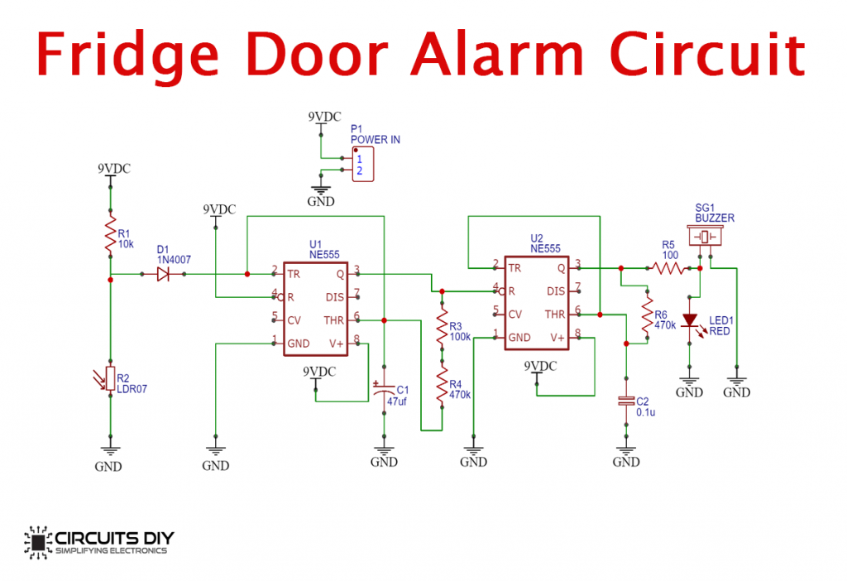
Proposed Circuit diagram:
Figure -1

Slide 6
Apparatus:
Resistors (220 Ω, 470KΩ X 2, 1 KΩ, 10k)
Electrolytic Capacitor
Operational Amplifier
LED-red
NE555 TIMER X 2
Ceramic Capacitor
BUZZER
TORCH LDR
Battery Clip/ POWER supply
DIODE

Slide 7
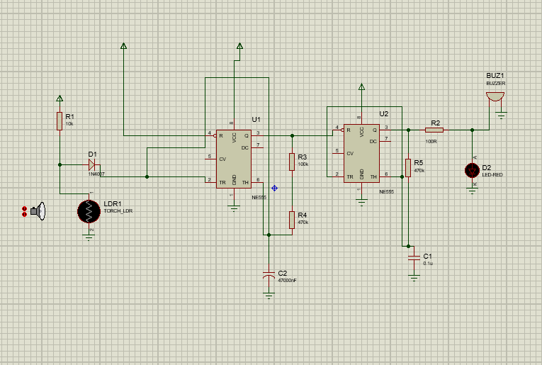
Circuit Simulations:
Schematic Capture-
Figure -2

Slide 8
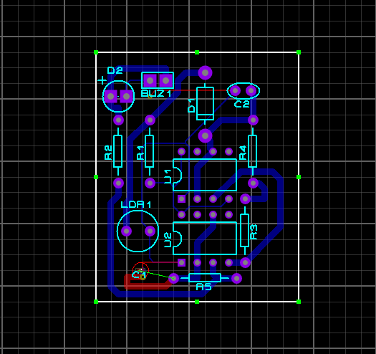
PCB Layout-
Figure -3

Slide 9
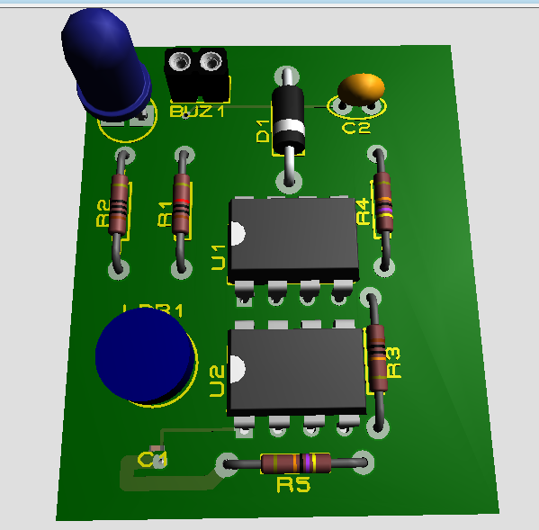
3D Visualizer-
Figure -4

Slide 10
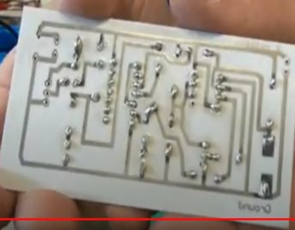
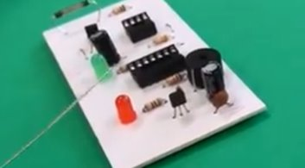
REAL IMPLEMENTATION:
Figure -5

Slide 11
Gantt chart:
Task | 7 April | 10 April | 11-15 April | 16-18 April | 19-20 April |  | 21-22 April
Topic Selection
Preparing Proposal reports
Literature Review
Design and Simulate the system
Test and Analysis
Writing Report

Slide 12
Cost estimation and tabular breakdown-
Name | Quantity | Price (BDT) | Source
Resistors (220 Ω, 470 KΩ, 1 KΩ) | 4 | 4*5=20tk | https://store.roboticsbd.com/
Electrolytic Capacitor | 1 | 2tk | https://store.roboticsbd.com/
Operational Amplifier | 1 | 9tk | https://store.roboticsbd.com/
LED | 1 | 5tk | https://store.roboticsbd.com/
NPN Transistor | 1 | 30tk | https://store.roboticsbd.com/
Ceramic Capacitor | 2 | 2*5=10tk | https://store.roboticsbd.com/
IC Jacket | 1 | 120tk | https://store.roboticsbd.com/
Soldering Iron | 1 | 309tk | https://store.roboticsbd.com/
Soldering Flux | 1 | 180tk | https://store.roboticsbd.com/
DC Battery | 1 | 40tk | https://store.roboticsbd.com/
Battery Clip |  | 9tk | https://store.roboticsbd.com/
Total Cost (BDT) |  | 734tk

Slide 13
Advantages-
Less energy consumption.
Improved refrigerator/freezer life.
Decrease in food spoilage.
Saves the compressor from any kinds of malfunction.

Slide 14
Conclusion:
This Fridge Door Alarm Circuit is a good solution which will indicate the user about the door in prolonged open condition. We can also set different pre-set time after which the audible indication has to be given. This is done here by using the versatile 555 timer IC under astable multivibrator mode and LDR. As soon as we open the Door of refrigerator, LDR senses it and start the countdown using 555 Timer, and after a preset time the buzzers starts beeping as alarm signal.

Slide 15
Thank you…

